Slide 1





Business presentation
prepared by: ANAS AMRATH
Business Development Manager
Company:
Alpha CCTV consultants, Colombo 08
Notes:
1

Slide 2


Executive Summary
INTRODUCTION:
Alpha CCTV Consultant is your trusted partner in cutting-edge surveillance solutions. As a leading name in
the industry, we specialize in providing tailored CCTV systems to safeguard your peace of mind.“
OBJECTIVES:
Introduce a comprehensive range of CCTV products.
Capture a significant market share within the first year.

Slide 3

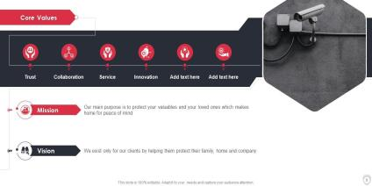
Vision and Mission
"Positioning Alpha CCTV Consultants as the foremost name in cutting-edge security solutions, safeguarding businesses and communities with innovation and integrity.“
Mission Statement: "We empower our clients by delivering customized, state-of-the-art CCTV systems, supported by expert consultancy and a dedication to staying ahead of emerging security challenges."

Slide 4


Products/Services Overview
“within our diverse range of offerings, you'll find:“
High-Resolution CCTV Cameras
Advanced DVR/NVR Systems
Access Control Integration
Expert Security Consultancy Services
Explore how our solutions seamlessly integrate to provide unparalleled security coverage.

Slide 5

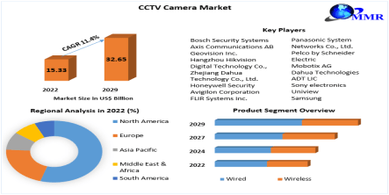
MARKET ANALYSIS
Industry Overview:
Growing security concerns drive steady growth in the surveillance industry.
Advancements like AI redefine surveillance with intelligent solutions.
Competitive Edge:
Alpha CCTV excels with expertise, premium products, and innovative solutions.
Targets businesses and individuals for a broad market reach.
Tech Trends:
Demand rises for smart surveillance and real-time remote monitoring.
AI integration reshapes traditional surveillance approaches.
Customer Focus:
Customers seek expert guidance, training, and tailored security solutions.
Accessibility and comprehensive support enhance the customer experience.
Regulatory Compliance:
Adherence to privacy regulations ensures legal and ethical practices.
Alpha CCTV aligns solutions with industry standards.
Opportunities/Challenges:
Opportunities in rising security awareness and tech adoption.
Challenges include rapid tech evolution and changing preferences.
Strategic Marketing:
Strategic marketing emphasizes expertise, quality, and affordability.
Geographical expansion aligns with growing security needs.
Future Outlook:
Continued market evolution towards intelligent, user-friendly solutions.
Alpha CCTV's innovation aligns with future industry trends.

Slide 6


COMPETATIVE LANDSCAPE
Competitor Analysis: Alpha CCTV Consultants distinguishes itself through:
Proven Expertise
Technological Innovation
Client-Centric Approach Discover why we are the preferred choice for businesses seeking robust security solutions.

Slide 7


TARGET AUDIENCE
Customer Profiles: Our solutions cater to a diverse clientele, including:
Corporate Enterprises
Educational Institutions
Government Organizations
Small and Medium Businesses Explore how Alpha CCTV Consultants tailors solutions to meet the unique needs of each sector.

Slide 8

UNIQUE VALUE PROPOSITION
Customized Solutions
24/7 Support and Maintenance
Future-Ready Technology Experience the Alpha Advantage – Your Trusted Security Partner.
Key Features: Smart Surveillance: Our CCTV systems go beyond mere monitoring. We integrate advanced analytics and artificial intelligence to deliver intelligent, proactive security solutions. High-Definition Clarity: Experience security in unprecedented detail. Our high-definition cameras ensure crystal-clear imaging, allowing you to see every detail with utmost precision. Seamless Integration: Our CCTV solutions seamlessly integrate with your existing security infrastructure, providing a comprehensive and unified security ecosystem for your property. Remote Accessibility: Stay connected and in control from anywhere in the world. Monitor your premises in real-time through user-friendly mobile applications, ensuring you are always in the loop. Customized Solutions: We understand that every property is unique. Our experts work closely with you to design customized CCTV solutions tailored to your specific needs, ensuring optimal coverage and protection. Reliability and Durability: Trust in systems built for resilience. Our CCTV solutions are designed to withstand diverse environmental conditions, providing round-the-clock surveillance you can depend on. Responsive Support: Our commitment doesn't end with installation. Enjoy peace of mind with our responsive customer support, ensuring your security system operates at its best, always. Choose us for a CCTV experience that transcends traditional surveillance. Elevate your security posture and embrace a new era of protection with our advanced CCTV solutions.

Slide 9

FINANCIAL OVERVIEW
Financial Highlights: Over the years, Alpha CCTV Consultants has demonstrated:
Steady Revenue Growth
Financial Stability
Strategic Investment in Technological Infrastructure
Our financial strength ensures continuity and reliability for our clients.

Slide 10



MARKETING AND SALES STRATEGY
.
Go-to-Market Strategy: Our approach involves:
Targeted Marketing Campaigns
Collaborative Partnerships
Consultative Sales Processes Learn how Alpha CCTV Consultants reaches and engages with clients effectively.
For sales strategy: Creating a successful sales strategy for Alpha CCTV Consultants involves a consultative approach, understanding client needs, and positioning the company as a trusted advisor. Live demonstrations and trials showcase the effectiveness of CCTV systems. Strategic partnerships expand product offerings, while tailored packages meet diverse client needs and budgets. Educational engagement through workshops and webinars positions the company as an industry authority. Proactive follow-up and responsive customer support contribute to long-term relationships and customer satisfaction. In essence, a client-focused approach, strategic partnerships, personalized solutions, educational initiatives, and strong support form the core of Alpha CCTV Consultants' effective sales strategy.

Slide 11

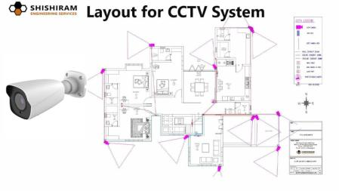

GROWTH PLAN
Expansion and Future Initiatives: As we move forward, Alpha CCTV Consultants is committed to:
Global Expansion
Research and Development
Continuous Training and Skill Development Explore the exciting future initiatives shaping Alpha's journey.
To fuel growth, Alpha CCTV Consultants will target new markets and forge local partnerships. The company will diversify its product portfolio, incorporating emerging technologies and forming strategic alliances in the security industry. Initiatives for customer retention, digital marketing, and employee development will be implemented. Alpha CCTV Consultants aims to become an educational resource, integrating smart features into solutions, ensuring quality, and prioritizing customer feedback for continual improvement. This comprehensive strategy positions the company for sustained success and relevance in the security sector.

Slide 12


COPORATE SOCIAL RESPONSIBILITY (CSR)
CSR Initiatives: Beyond business, Alpha CCTV Consultants is dedicated to:
Community Safety Workshops
Environmentally Conscious Practices
Social Responsibility Initiatives Discover how we make a positive impact beyond surveillance.
Alpha CCTV Consultants is deeply committed to Corporate Social Responsibility (CSR), centering our efforts on the holistic principles of People, Planet, and Profit. Our CSR initiatives include active stakeholder engagement, eco-friendly practices for environmental sustainability, and community-driven programs for a positive societal impact. We prioritize ethical business conduct, ensuring the well-being of our employees, and actively contribute to philanthropic endeavors within our communities. Transparent reporting serves as a testament to our dedication, solidifying Alpha CCTV Consultants as a socially responsible brand with a focus on sustainable business practices.

Slide 13



TEAM AND CULTURE
Team Showcase: Meet our team of seasoned experts, including:
Certified Security Consultants
Technical Support Specialists
Innovation Enthusiasts Learn about the Alpha culture that fosters collaboration, innovation, and excellence.
At Alpha CCTV Consultants, our success is rooted in a collaborative team culture. We prioritize cross-functional collaboration, innovation, and continuous learning. Upholding ethical conduct, fostering inclusivity, and recognizing the value of diversity are central to our company culture. We empower our team, encourage adaptability, and appreciate the importance of work-life balance. Social responsibility, effective communication, and regular team-building activities contribute to a positive and motivated work environment. Together, we strive to excel in the dynamic field of security technology, ensuring our customers receive top-notch solutions and service.

Slide 14



SUCCESS STORIES/TESTIMONIALS
Improved Security
Cost-Efficient Solutions
Exceptional Service Read how Alpha CCTV Consultants has transformed security for businesses like yours.
Alpha CCTV Consultants has truly transformed our security landscape. Their innovative CCTV solutions, seamlessly integrated, have not only deterred potential threats but also streamlined our operations. Alpha's dedication to understanding our unique needs resulted in a customized approach, making them stand out in the industry. Their prompt and reliable service has solidified our trust in them as the go-to partner for comprehensive security solutions.

Slide 15


CONTACT INFORMATION AND Q&A
Contact Details: Connect with Alpha CCTV Consultants for inquiries, consultations, and support:
Phone: [0123454346]
Email: [Info@alpha11cctvconsultants@.com]
Website: [URL: http://www.alphacctv.com] Thank you for your time! Open the floor for questions and discussions.
Connect with us on social media:
LinkedIn
Twitter
Facebook

Slide 16


Thank you for your time!

